Slide 1


Strategic Growth Framework
Waterloo Bolivar
CEO Briefing
__CONFIDENTIAL____
Presented By:
City of Salisbury & Holmes Dyer
05 April 2022
Notes:
CoS to introduce

Slide 2
Presentation Content
Study Objectives
Project Milestones
Engagement Process Summary
Future Rezoning/Infrastructure Process Diagram
Industry Needs Analysis – Key Findings (Technical Level)
Draft Structure Plan (Technical Level)
Community Engagement Material
EM Feedback
Notes:
CoS to Present

Slide 3
Study Objectives
  A fully informed and coordinated growth framework for the area, to inform future Council decisions relating to more detailed infrastructure planning budget requirements and the orderly sequencing of Council and Proponent led Code Amendments
  Identify potential infrastructure agreement requirements and likely precinct boundaries.
  Identify land supply, market depth, economic growth and job creation targets and potential delivery timeframes and options for land release.
  Provide a high level planning framework to advocate to State Government as part of the upcoming Regional Plan process to commence in 2022, replacement to the current 30 Year Plan for Greater Adelaide
Notes:
CoS to present

Slide 4
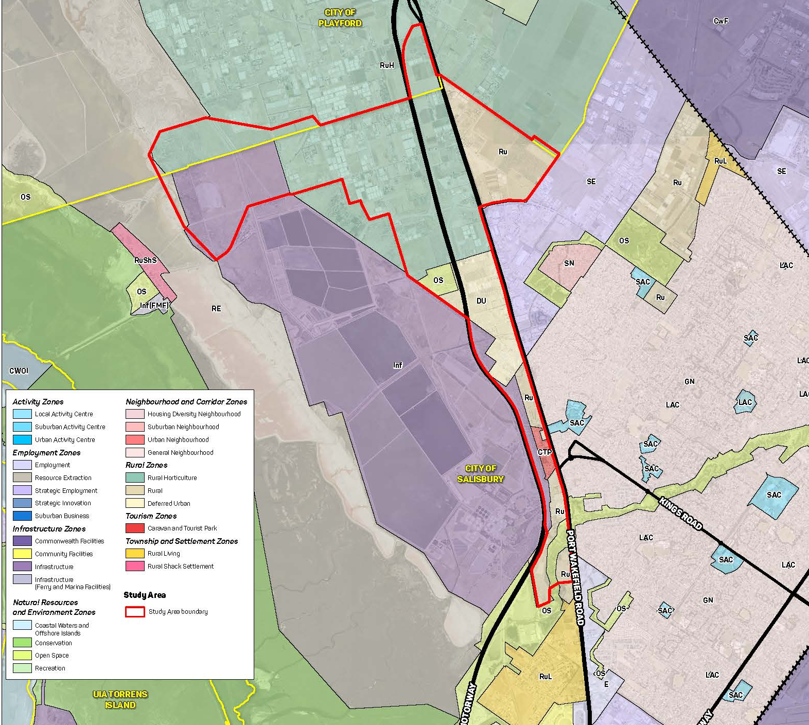
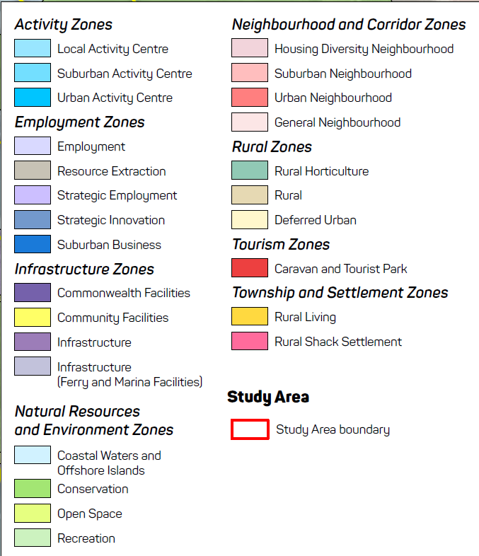
Study Area Boundary
Notes:
CoS to present

Slide 5
Strategic Growth Framework - Key Milestones
Feb/Mar 2022
Apr 2022
May 2022
June 2022
July 2022
MILESTONE 01
MILESTONE 02
MILESTONE 03
MILESTONE 04
MILESTONE 05
Site Constraint Desktop Analysis
Economic Profile
Market Review
Land Capability Assessment
Service Infrastructure Investigations
Government/Key Stakeholder Engagement
Finalise Structure & Precinct Plans
Summarise Infrastructure Requirements / Cost Estimates
Prepare Final Report for Endorsement
Notes:
CoS to Present

Slide 6

Engagement Plan
Notes:
CoS to present

Slide 7
Stakeholder Mapping
Waterloo / Bolivar Precinct subject to Strategic Growth Framework
City of Playford
Owners/Occupiers land within Study Area
Developers with an interest in the Study Area
Service Authorities
Federal Departments
Department for Infrastructure & Transport
Wider Community
Department Planning & Land Use Services
State Agencies
Advocacy Groups
City of Salisbury Staff & Elected Members
Notes:
CoS to present

Slide 8
Strategic Growth Framework Engagement Stages
One on One Discussions Key Infrastructure Providers/ State Agencies
PLUS
DIT
City of Playford
SA Water/ SA Power Networks
Office of Recreation, Sport & Racing
Broad Stakeholder Engagement
State Agencies
Federal Departments
MPs (State & Federal)
Service Authorities
Advocacy Groups
Key Local Interest Groups
Community Engagement
4 Week Period
Engagement with Owner/Occupiers in the Study Area
Project Website Launch
Online Survey
Drop-in Session
Identify people who wish to stay informed
Project Engagement Plan
Strategic Growth Framework
Future Formal Consultation Activities guided by Stakeholder Mapping & Community Charter:
Key Landowners in Development Precincts
Code Amendment Rezonings
Infrastructure Negotiations
Notes:
CoS to present

Slide 9
Future Rezoning/Infrastructure Process Diagram
Notes:
Holmes Dyer – Stephen to Present

Slide 10
Rezoning (Code Amendment Process)
Proposal to initiate Code Amendment to Minister for Planning
Pre-Consultation with Landowners, Key Agencies to agree scope / timeframes
Infrastructure Delivery Mechanism (where required)
Agree the preferred infrastructure agreement mechanism depending on need
Undertake pre-consultation with affected land owners, relevant utilities/agencies
Draft the Code Amendment, Prepare Engagement Plan and undertake technical investigations
Undertake community engagement
Prepare Engagement Outcome Report and identify and recommended changes to Minister for Planning
Code Amendment Approved/Refused
Document technical infrastructure interventions, costings, responsibilities and the infrastructure agreement legal wording
Undertake stakeholder meetings to agree to content
Finalised infrastructure agreements and execute legal documentation
Monitor & Enforce infrastructure delivery in line with agreements concurrent with rezoning and project delivery timelines
Notes:
Holmes Dyer – Stephen to Present

Slide 11
Strategic Investigations & Market Analysis
Notes:
Holmes Dyer – Stephen to Present

Slide 12
Employment Land Market Analysis- Salisbury
Source: CoreLogic, 2022
  Key Findings:
  Strong growth in commercial and industrial sales activity in Salisbury since 2019
  Median land sizes have remained relatively constant but there has been a notable lift in median sale price in recent years
  Salisbury has more sales, larger sites at higher values than Playford
Notes:
Holmes Dyer – Stephen to Present

Slide 13
Commercial and Industrial Sales in Salisbury 2008 - 2022 (Jan) by Land Size
Land Size Categories (m2) | Count | Median Land Size (m2) | Median Sale Price
<1999 | 392 | 535 | $385,000
2000 - 4999 | 271 | 3005 | $780,000
5000 - 9999 | 118 | 6,579 | $1,008,250
10,000 - 19,999 | 79 | 12,830 | $1,716,000
20,000 + | 97 | 32,060 | $3,025,000
Total | 957 | 2,503 | $700,000
Source: CoreLogic, 2022
  Key Findings:
  Nearly 70% of Sales are for lots less than 5000m² in area
  Over 10% of sales are for lots greater than 2 hectares in area (median size of 3.2 hectares)
Notes:
Holmes Dyer – Stephen to Present

Slide 14
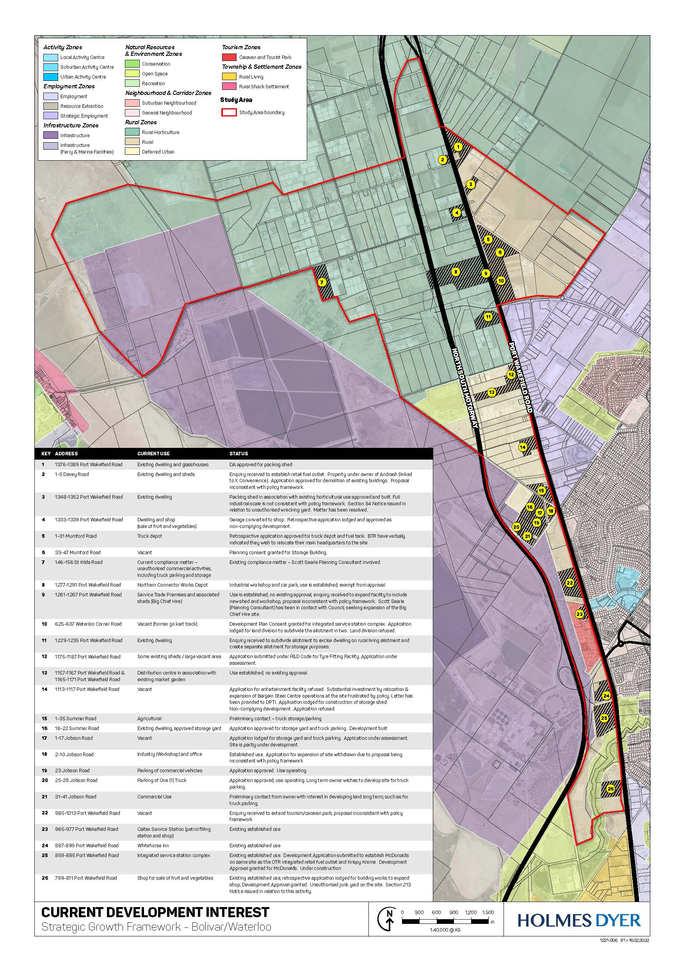
Development Enquiries in
Study Area c. 5-year period
  Study Area covers 950 hectares of land and approximately 280 individual land parcels
  76 hectares of land affected by Development Applications or development enquiries in last circa 5 years
  Total study area circa 508 hectares (if you exclude transport corridors, open space, Caravan & Tourist Park and existing improved commercial land)
  This demonstrates existing demand for about 15 gross hectares per annum.
Notes:
Holmes Dyer – Stephen to Present

Slide 15
Study Area Delivery Predictions
Development of 508 hectares of employment land at 14-15 gross hectares over 35 years could deliver the following economic outcomes using benchmark standards
    915,000m2 of employment floor space
    6,715 permanent employees (FTE)
Notes:
Holmes Dyer – Stephen to Present

Slide 16
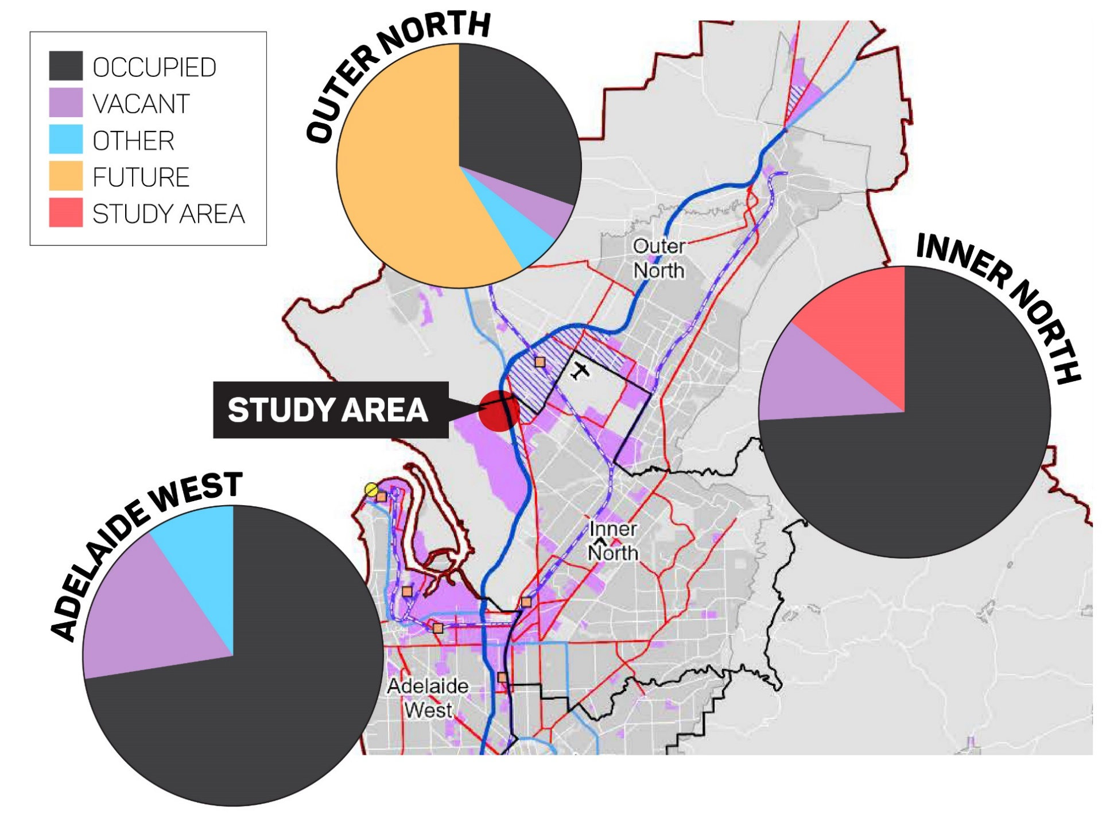
Regional Context
Notes:
Holmes Dyer – Stephen to Present

Slide 17
Draft Structure Plan (Technical Level)
Notes:
Holmes Dyer – Chantal to Present
Draft incorporates desktop constraints, findings from study area tour and preliminary feedback from operational CoS Staff.
Will evolve based on feedback from Council staff/ EM’s, Service Authorities, Agencies & Community across next project phase.
Once refined, will be used to identify discrete precincts for precinct plans to be produced

Slide 18
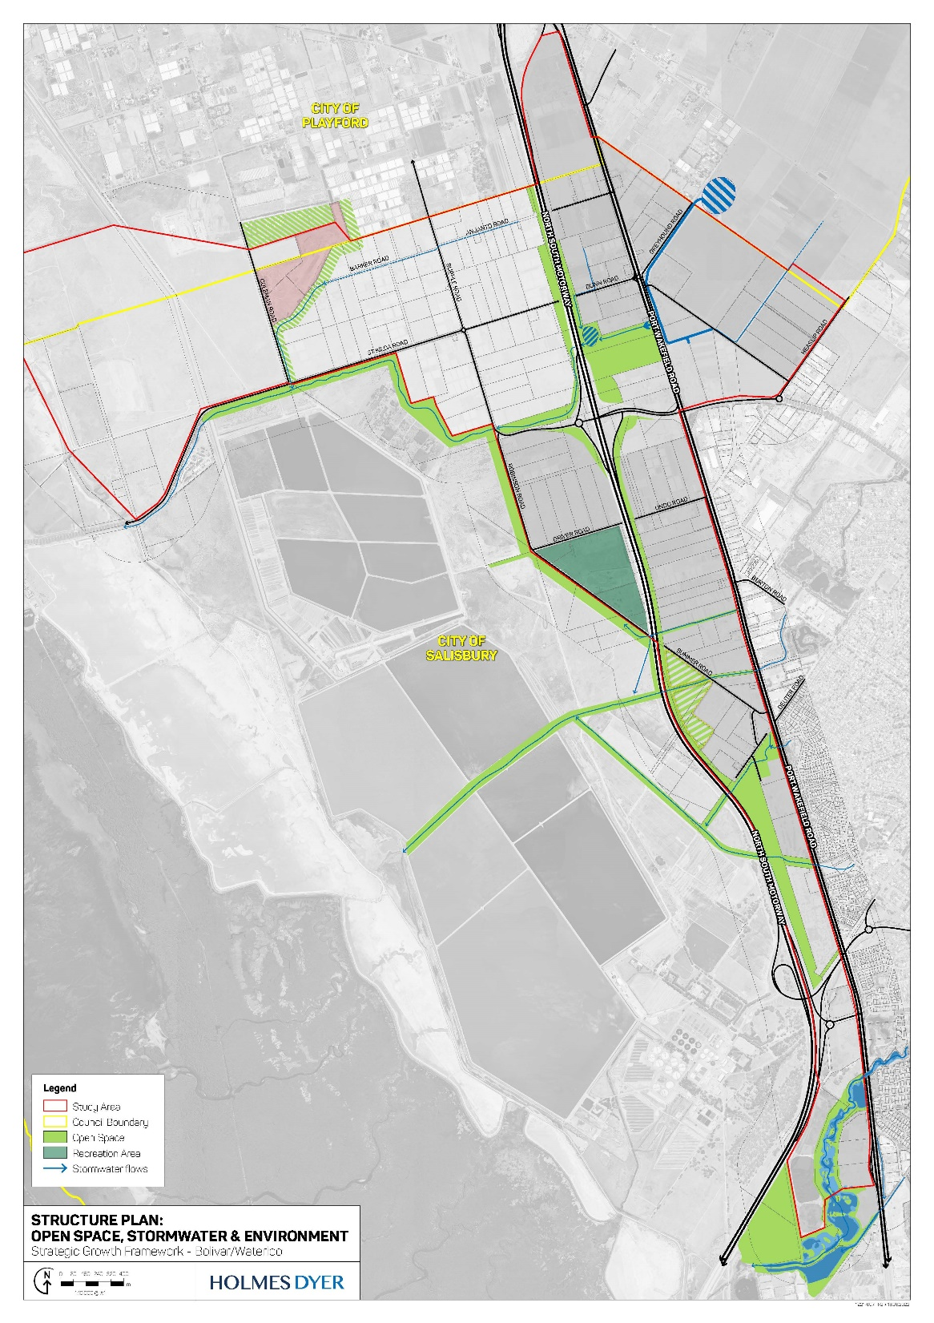
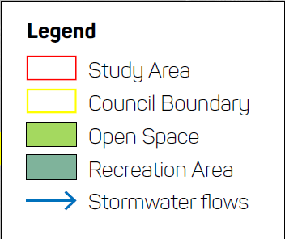
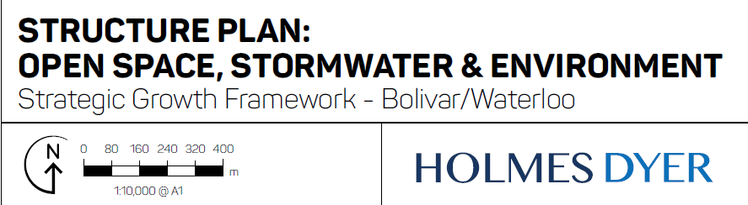
DRAFT – Structure Plan
Open Space, Stormwater
& Environmental Overlay
Stormwater Corridor Connections/Detention Areas
Open Space Corridor Connections including along Northern Connector and out towards St Kilda
Active Recreation Zone “Noisy Sports”
Environmental and Carbon Sequestration Opportunities
Notes:
Holmes Dyer – Chantal to Present

Slide 19
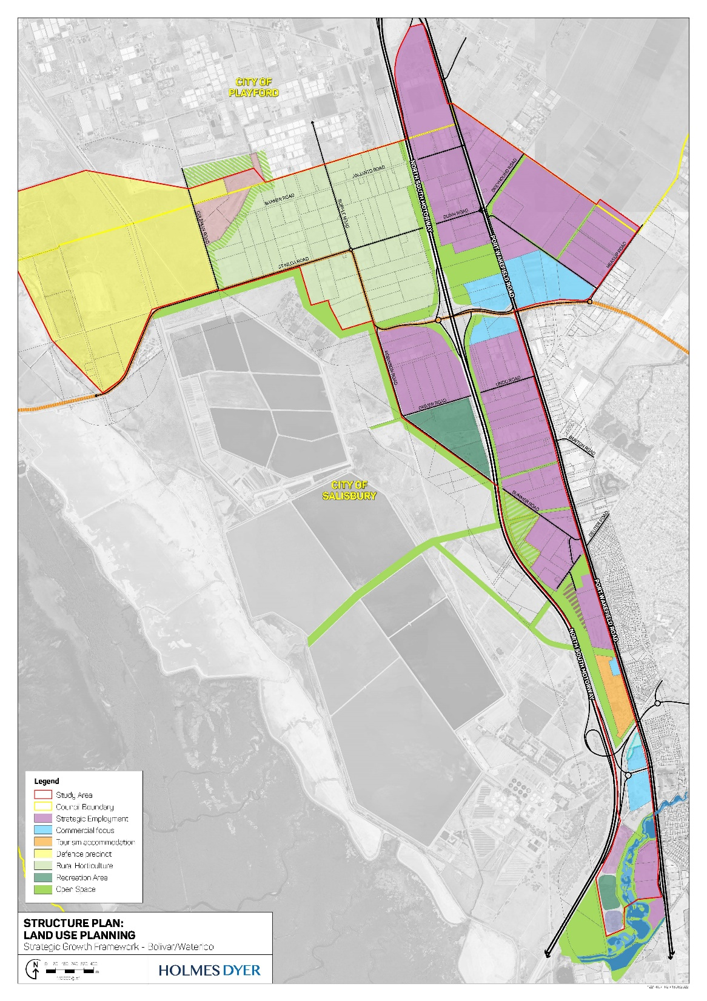
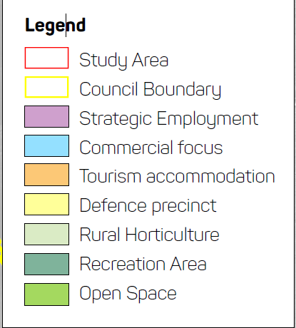
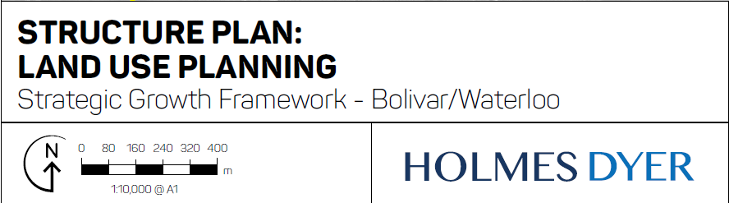
DRAFT – Structure Plan
Proposed Land Use
Employment Land reflecting the future required supply
Commercial focus areas around key interchanges for exposure and accessibility
Active Recreation Zone “Noisy Sports”
Retention of high value rural horticultural
Notes:
Holmes Dyer – Chantal to Present

Slide 20
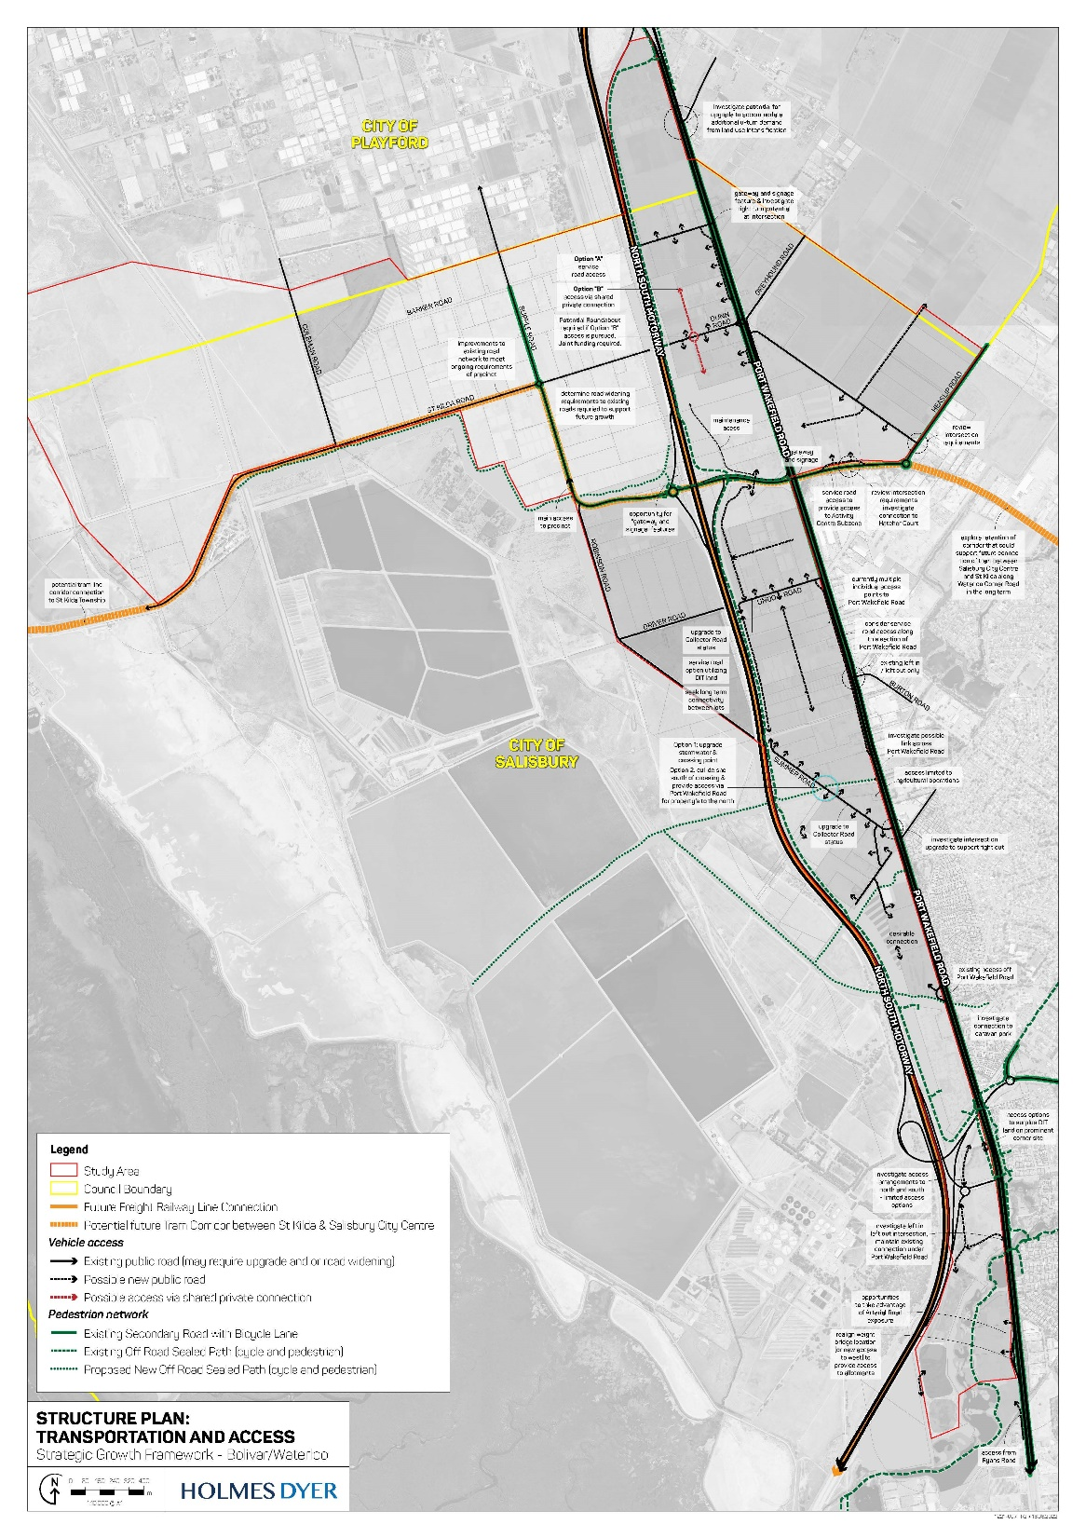
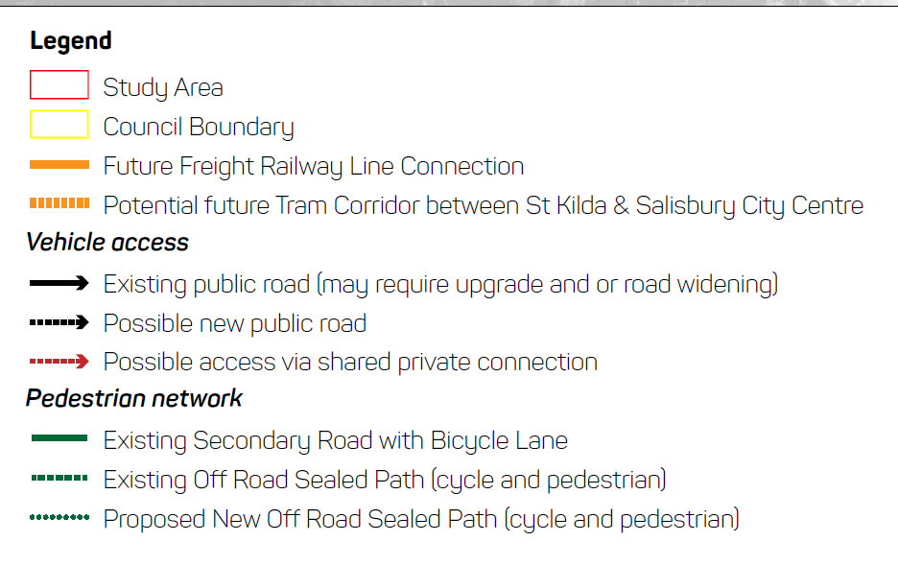
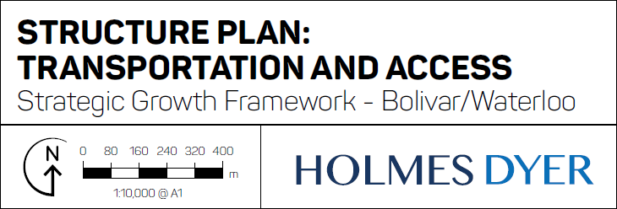
DRAFT – Structure Plan
Traffic & Road Access
Range of road access and infrastructure delivery options
Important to understand where access will not be supported by DIT.
Identify key existing road connections, upgrades, road widening and turn-around.
Identify development order & partnerships
Notes:
Holmes Dyer – Chantal to Present

Slide 21
Community Engagement Material
Notes:
Holmes Dyer – Chantal to Present

Slide 22
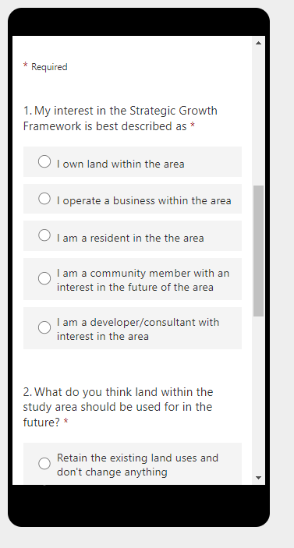
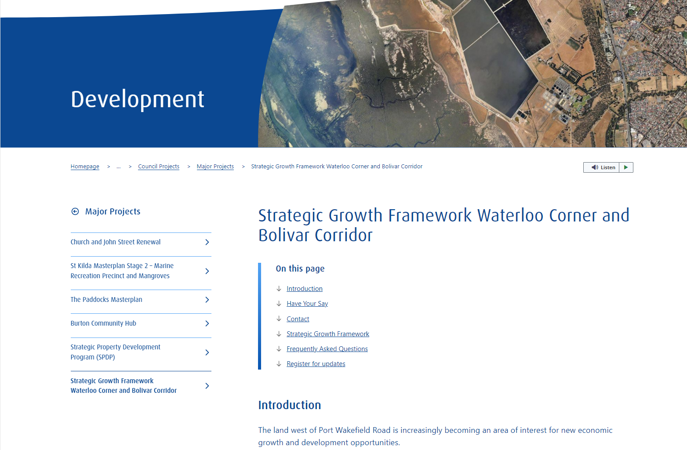
Community Engagement
Commence in May (Minimum 4-week period)
Focused on landowners within the Study Area but opportunity for general community to also provide feedback
FAQ, Fact Sheet, Survey and Drop-in Session at the Salisbury Community Hub to seek feedback on development intention.
<CLICK TO ACCESS WEBSITE>
Notes:
Holmes Dyer – Chantal to Present

Slide 23
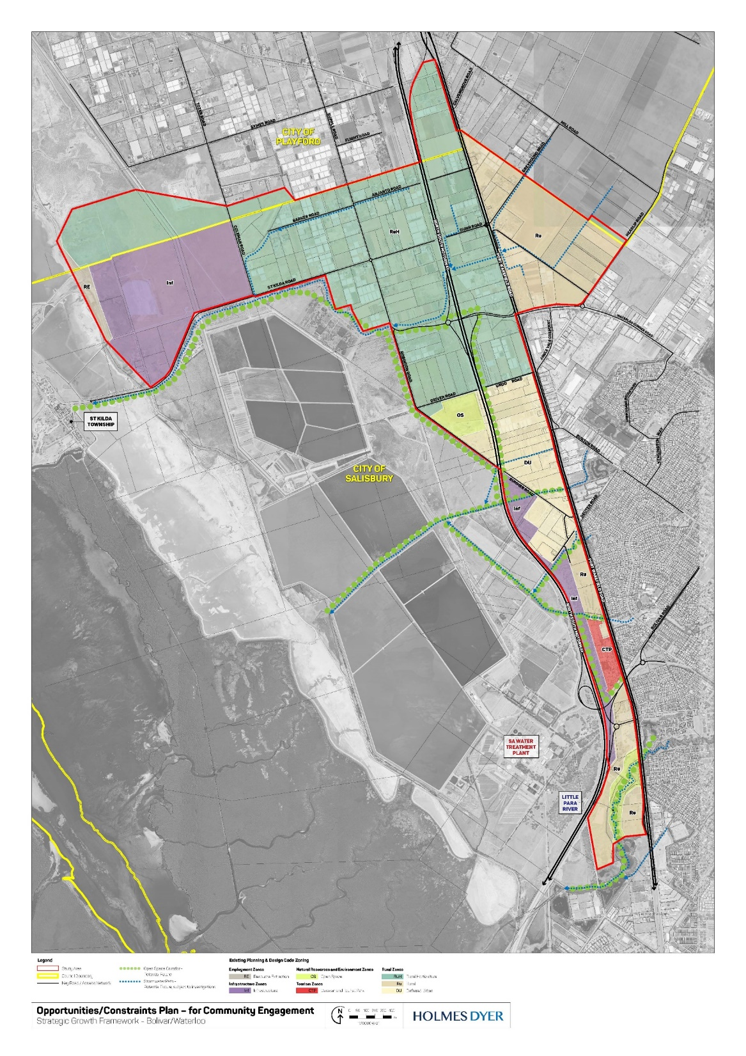
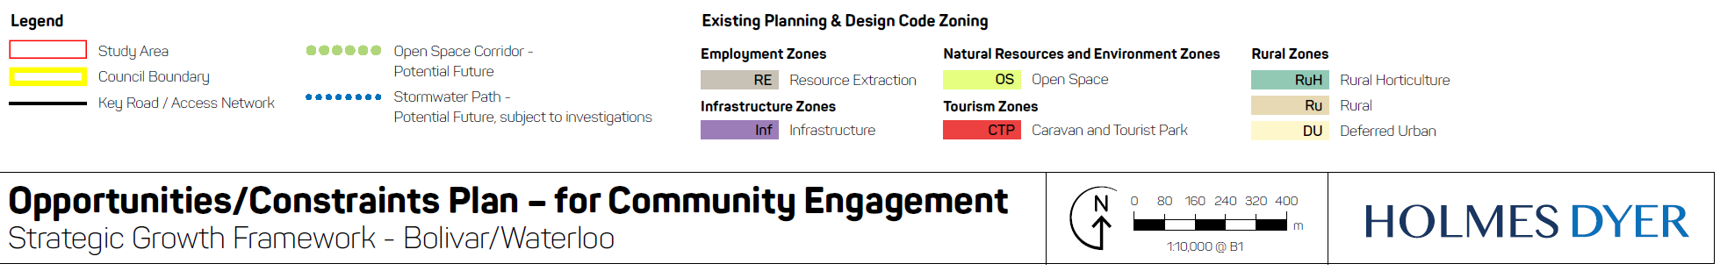
Community Engagement
Engagement Plan that will be used with the community.
Clearly define the study boundary and land part of the study
High level/ existing state
Identifies existing zoning, existing road corridors and current and future open space and stormwater corridors
Notes:
Holmes Dyer – Chantal to Present

Slide 24
Questions/Feedback
Notes:
Group Response – As required by topic

