Slide 1
Recreation Assets – Management

Slide 2
Recreation Assets - Management
The City of Salisbury has 4 managed recreation assets:
Little Para Golf Course
Ingle Farm Recreation Centre
Parafield Gardens Recreation Centre
Salisbury Aquatic Centre
A management agreement is in place with Belgravia Leisure to manage the golf course and recreation centres. This expires on 30 June 2023.
The Salisbury Aquatic Centre, as a new centre, requires a manager.

Slide 3
Recreation Assets - Management
Who?
Council?
A generic recreation services provider?
A mixture of experts?

Slide 4
Recreation Assets - Management
Community Impact
The impact of a recreation facility is shaped by:
Management (expertise, specialisation, capability)
Function (design and condition of the asset)
Consumer sentiment/demand

Slide 5
Recreation Assets - Management
Management Considerations
Staffing | Ability to attract and retain an appropriately skilled workforce that can meet the span of service arrangements.
Intellectual Property | Access to researched consumer centred product.
Technology | Customer management systems.
Market expertise | Specialised understanding of ‘product’ e.g. golf and the associated market (i.e. market approaches and segmentation) .
Innovation opportunities | Awareness of, and risk appetite for, new market opportunities (including capital investment).
Set up/administration processes | Readiness/ability to leverage existing operations.
Management Cost | Management expertise that can leverage experience and infrastructure to deliver efficiency.
Operational Control | Ability to design and direct programming
Risk | Legislative compliance (water quality, safety, food handling etc)

Slide 6
Recreation Assets - Management
Benefits of External Managers
External partners will likely see the opportunities differently
In addition to bringing expertise, systems and scalability – they may offer new investment that improves services/function
It is difficult to determine the merits of internal versus external management until the market is tested.

Slide 7
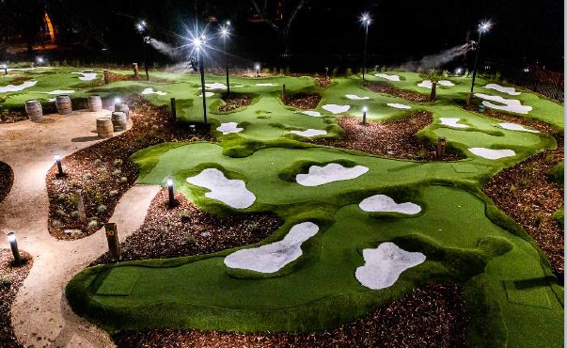
Recreation Assets - Management
Case Study – Regency Park
EOI – attracted Greenspace Management – a golf specialist (commenced FY2021)
In addition to managing operations, injected capital - new high calibre put put course
Changed name from ‘golf club’ to ‘community golf course’
Moved from memberships to ‘season passes’
Significant online focus to operations and presence
29,581 participants in 2019/20 to 49,408 in 2020/21

Slide 8
Recreation Assets - Management
Little Para Golf Course
An outstanding natural environment, an intertwining river, full length par 3 holes, good sized greens and multiple bunkers makes Little Para Adelaide’s best par 3 golf course. And………….. irrigation is free!
But…………….. it needs more love.

Slide 9
Recreation Assets - Management
Little Para Golf Course - Performance
Managed by Belgravia Leisure at an annual cost of approx. $240,000
Contract mirrors service level at time of negotiation/not aspirational
Review found a range of functional (capital) limitations
Performance remains poor e.g.:
Tee time utilisation = 16%
2021 saw a significant increase in participation in golf (COVID):

Slide 10
Recreation Assets - Management
Let Market Experts Identify Opportunity
Utilisation of EOI enables Council to invite management proposals from the private sector for (either individually, a mixture or all):
Salisbury Aquatic Centre
Little Para Golf Course
Recreation Centres (Ingle Farm and Parafield Gardens)
Most significant risk is lost investment and time facilitating the EOI process (will require external assistance to prepare EOI)
In addition, current Belgravia contract does not provide option for roll-over

Slide 11
Recreation Assets - Management
Timing

